Slide 1
Evaluation Selection Team
A Node.js Odyssey

Slide 2





About me
Currently at Workable with the amazing evaluation-selection team
Worked with Spring, Grails, Node.js, Rails
Has used Java, Javascript, Typescript, Ruby, Groovy
Fun with dead languages - Damian Conway
“Languages shape the way we think”

Slide 3

Node.js Basics
Node.js is an open-source, cross-platform JavaScript runtime environment built on Chrome's V8 JavaScript engine.
It enables the execution of JavaScript code server-side, outside a web browser.
It can handle asynchronous I/O operations, making it a great choice for real-time web applications.

Slide 4
Node.js key features
Cross-platform
Event-Driven and Asynchronous
Single-Threaded
NPM ecosystem
Quick execution of code
Fast data streaming
Notes:
Cross-platform: NodeJS is a runtime environment that can be used on various operating systems, including Windows, Linux, and macOS. This allows developers to easily build and deploy applications on different platforms without any compatibility issues.
Event-Drive and Asynchronous: The API libraries of NodeJS are all asynchronous, and non-blocking, meaning servers don't wait for API data. They use Events to track previous API responses and move on to the next request.
NPM ecosystem: The Node Package Manager (NPM) provides developers with a vast ecosystem of modules and packages. These modules enhance the development process and help integrate NodeJS with other technologies and frameworks, and to reuse code that has already been written.
Single-Threaded: NodeJS uses a single-threaded event loop architecture to handle multiple requests simultaneously without creating new threads for each request. This makes it highly efficient and scalable, even on hardware with limited resources.
Quick execution of code: NodeJS utilizes the V8 JavaScript Runtime engine, which is also utilized by Google Chrome. It has a wrapper for the engine that makes it faster, resulting in quicker preparation of requests in NodeJS.
Fast data streaming: NodeJS processes data quickly, even when it's being transmitted in multiple streams. It can process and upload a file at the same time, which saves a lot of time. This makes data and video streaming faster overall.

Slide 5
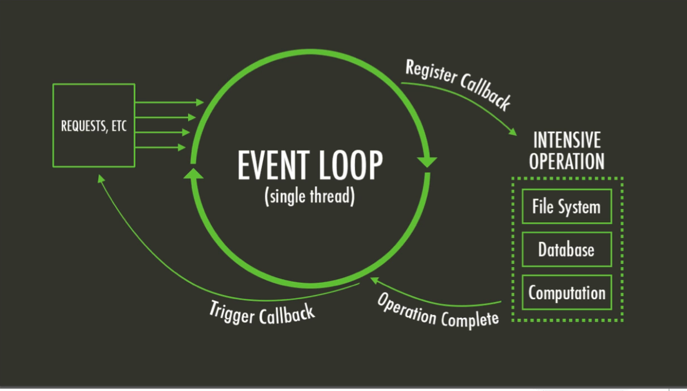
Event loop
The event loop is what allows Node.js to perform non-blocking I/O operations by offloading operations to the system kernel whenever possible.
When one of these operations completes, the kernel tells Node.js so that the appropriate callback may be added to the poll queue to eventually be executed.
IMAGE
Notes:
The event loop is what allows Node.js to perform non-blocking I/O operations — despite the fact that JavaScript is single-threaded — by offloading operations to the system kernel whenever possible.
Since most modern kernels are multi-threaded, they can handle multiple operations executing in the background. When one of these operations completes, the kernel tells Node.js so that the appropriate callback may be added to the poll queue to eventually be executed.

Slide 6
Non Blocking / Blocking IO
// Blocking I/O operation - Synchronous
const data = fs.readFileSync('example.txt', 'utf-8');
console.log('File contents:', data);
// The program will not proceed until the entire file is read
console.log('Program continues...');
// Non-blocking I/O operation - Asynchronous
fs.readFile('example.txt', 'utf-8', (err, data) => {
if (err) {
console.error('Error reading file:', err);
return;
}
console.log('File contents:', data);
});
// Program continues without waiting for the file read operation to complete
console.log('Program continues...');

Slide 7
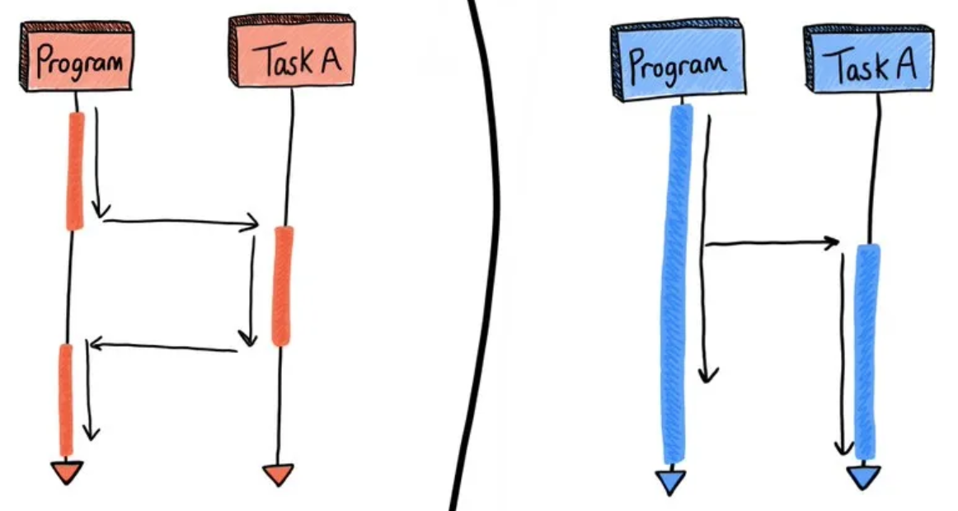
Asynchronous Programming
Asynchronous programming is a method of parallel computer programming that enables a process to run separately from the primary function of the program.
Once the process completes, it communicates this information and may impact the primary function
Callback, Promises and Aync/ Await are the techniques for writing asynchronous JavaScript
Notes:
Multiple threads/ Event loop in single thread

Slide 8
Callbacks
const fs = require('fs');
function readFileCallback(filePath, callback) {
fs.readFile(filePath, 'utf8', (err, data) => {
if (err) {
callback(err, null);
} else {
callback(null, data);
}
});
}
// Example usage
readFileCallback('example.txt', (err, data) => {
if (err) {
console.error('Error:', err);
} else {
console.log('Data:', data);
}
});
Callbacks: A Callback is a function that is passed as an argument to another function.
The function that takes in a function/functions (callback function) as an argument/arguments is called higher-order function.
Callback functions are executed inside of the higher-order function.

Slide 9
Promises
const fsPromises = require('fs').promises;
function readFilePromise(filePath) {
return new Promise((resolve, reject) => {
fsPromises.readFile(filePath, 'utf8')
.then(data => resolve(data))
.catch(error => reject(error));
});
}
// Example usage
readFilePromise('example.txt')
.then(data => console.log('Data:', data))
.catch(error => console.error('Error:', error));
A Promise is an object that presents a value that may not be available yet, but will be resolved at some point in the future.
It allows us to associate handlers with an asynchronous action that will eventual return a success value or a failure reason.

Slide 10
Async/Await
Async-await is is a syntax feature in JavaScript that simplifies working with asynchronous code, making it look and behave more like synchronous code
It was introduced in ECMAScript 2017 (ES8) and provides a more concise and readable way to work with Promises
const fsPromises = require('fs').promises;
async function readFileAsyncAwait(filePath) {
try {
const data = await fsPromises.readFile(filePath, 'utf8');
console.log('Data:', data);
} catch (error) {
console.error('Error:', error);
}
}
// Example usage
await readFileAsyncAwait('example.txt');
readFileAsyncAwait('example.txt')
.then(data => console.log('Data:', data))
.catch(error => console.error('Error:', error));

Slide 11
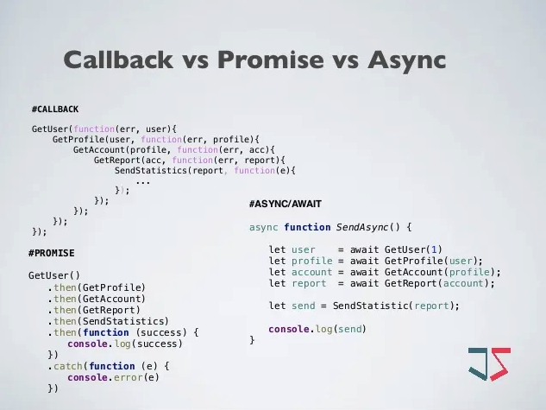
Callback vs Promise vs Async
Callbacks
Simple and widely supported in older JavaScript code.
Straightforward for handling asynchronous operations.
But.. can lead to callback hell (nested callbacks), making code hard to read and maintain.
Error handling can be verbose and error-prone.
Promises
Improved readability over callbacks.
Provides a cleaner syntax for error handling using .catch().
But… still involves some boilerplate code.
Async/Await
Highly readable and easy to understand, resembling synchronous code.
Simplifies error handling with try/catch.
Allows for more natural sequential code.
But… not supported in older JavaScript environments.

Slide 12
Async Local Storage
Storage for asynchronous tasks
API provided from Node.js (from v12.17.0, v13.14.0, v14.0.0)
From the official Node.js docs
Uses async_hooks under the hood
Solution for having a global request context
Java Thread Local (docs)

Slide 13
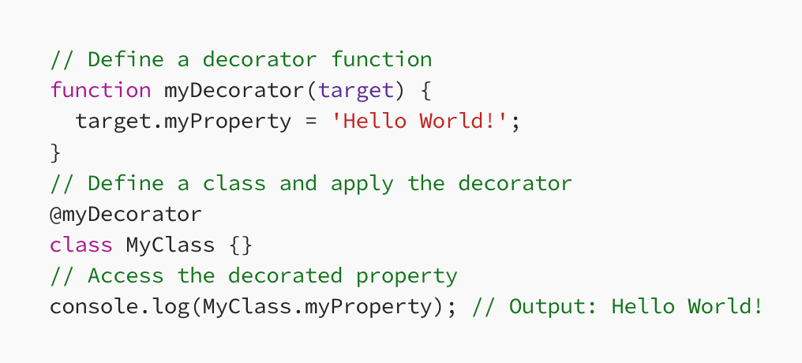
Decorators
Were introduced in node 15 in 2020
They provide a way to modify or extend the behavior of a class, method, or property.
Decorators can be used to implement cross-cutting concerns such as logging, caching, validation, or authentication in a more modular and reusable way.
They are essentially functions that take a target object (e.g., a class, method, or property) and modify it by adding new functionality or modifying its existing behavior.
Decorators are applied using the “@” syntax, and they can be stacked or composed to create more complex behavior.
Notes:
Reflect API in TypeScript
The Reflect API in TypeScript is an extension of the Reflect object introduced in ECMAScript 6 (ES6) and ES2015. The Reflect object provides a set of static methods that can be used for reflective programming, enabling developers to interact with JavaScript and TypeScript objects in a more dynamic way. The Reflect API is often used with decorators and metadata reflection.

Slide 14
Typescript
TypeScript is a free and open-source high-level programming language developed by Microsoft that adds static typing with optional type annotations to JavaScript.
TypeScript is a superset of JavaScript. It is designed for the development of large applications and transpiles to JavaScript
TypeScript aims to provide developers with a more structured and maintainable way to write JavaScript code while preserving the flexibility and compatibility of the JavaScript language. It has gained significant popularity, especially in large-scale and enterprise-level web development projects

Slide 15
Typescript Benefits
Static Typing
Early Error Detection
Improved Code Readability
Code Maintainability
Refactoring Support
Enhanced Developer Productivity
Advanced Language Features
Strong Ecosystem and Community
Notes:
Static Typing:
TypeScript introduces static typing, allowing developers to define types for variables, function parameters, and return values. This helps catch type-related errors during development, reducing the likelihood of runtime errors.
Enhanced Code Quality:
The use of static typing and interfaces contributes to improved code quality by providing clearer documentation and enabling better tooling support. IDEs can offer features like autocompletion, refactoring, and type checking.
Early Error Detection:
Type checking at compile-time helps catch errors before the code is executed. This can significantly reduce the debugging effort and improve the robustness of applications.
Improved Code Readability:
Explicitly declaring types enhances code readability by providing clear documentation about the expected data types and structures. This can make the code more self-explanatory and understandable.
Code Maintainability:
TypeScript's features, such as interfaces and static typing, make it easier to understand the structure of the code. This, in turn, contributes to better code maintainability, especially as projects grow in size and complexity.
Refactoring Support:
TypeScript's static analysis capabilities enable powerful refactoring tools. Developers can confidently refactor code with the assurance that the type system will catch potential issues.
Enhanced Developer Productivity:
Features like autocompletion, intelligent code navigation, and type inference in modern IDEs (such as Visual Studio Code) enhance developer productivity. The tooling support provided by TypeScript helps developers write code more efficiently.
Compatibility with JavaScript:
TypeScript is a superset of JavaScript, meaning that existing JavaScript code can be gradually migrated to TypeScript. This allows for a smooth adoption process without requiring a complete rewrite.
Advanced Language Features:
TypeScript includes advanced language features such as decorators, enums, and generics, providing developers with additional tools to express complex ideas in a concise and type-safe manner.
Strong Ecosystem and Community:
TypeScript has a strong and growing community, and it is widely adopted in the industry. The TypeScript team actively maintains the language, and the ecosystem includes numerous libraries and frameworks with TypeScript support.

Slide 16
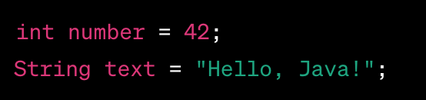
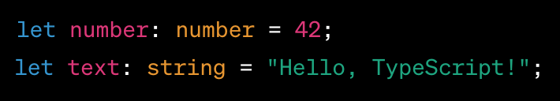
Types
Java is a statically-typed language.
The type of a variable is known at compile-time.
TypeScript is a superset of JavaScript.
Adds static typing to the language.
Allows dynamic typing when necessary
Powerful type inference system, allowing the compiler to deduce types based on context.
Notes:
Java is a statically-typed language, which means that the type of a variable is known at compile-time. Java has a rich set of built-in types, including primitive types (int, double, boolean, etc.) and reference types (classes, interfaces, arrays, etc.).
Java supports strong typing, and once a variable is declared with a certain type, its type cannot be changed during its lifetime. Type information is crucial for the Java compiler to enforce type safety and catch potential errors before runtime.
TypeScript is a superset of JavaScript that adds static typing to the language. TypeScript introduces a type system that allows developers to specify the types of variables, function parameters, return types, and more. However, TypeScript is also designed to be flexible, allowing for gradual adoption of types in existing JavaScript code.
TypeScript has a powerful type inference system, allowing the compiler to deduce types based on context.
TypeScript types include basic types like number, string, boolean, and complex types like interfaces, enums, and union types. TypeScript's type system enhances code readability, provides better tooling support, and helps catch errors during development.

Slide 17
Typescript Advanced Features
Union and intersection types
Keyof
Typeof
Conditional types
Utility types
Infer type
Mapped types

Slide 18
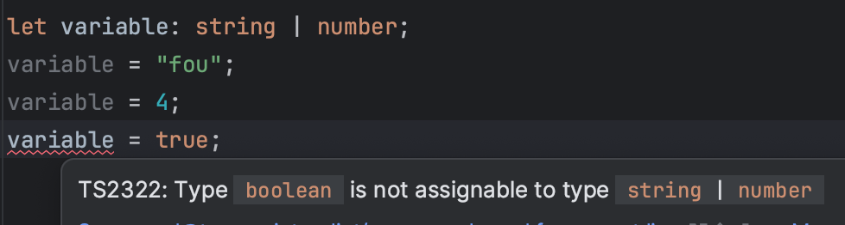
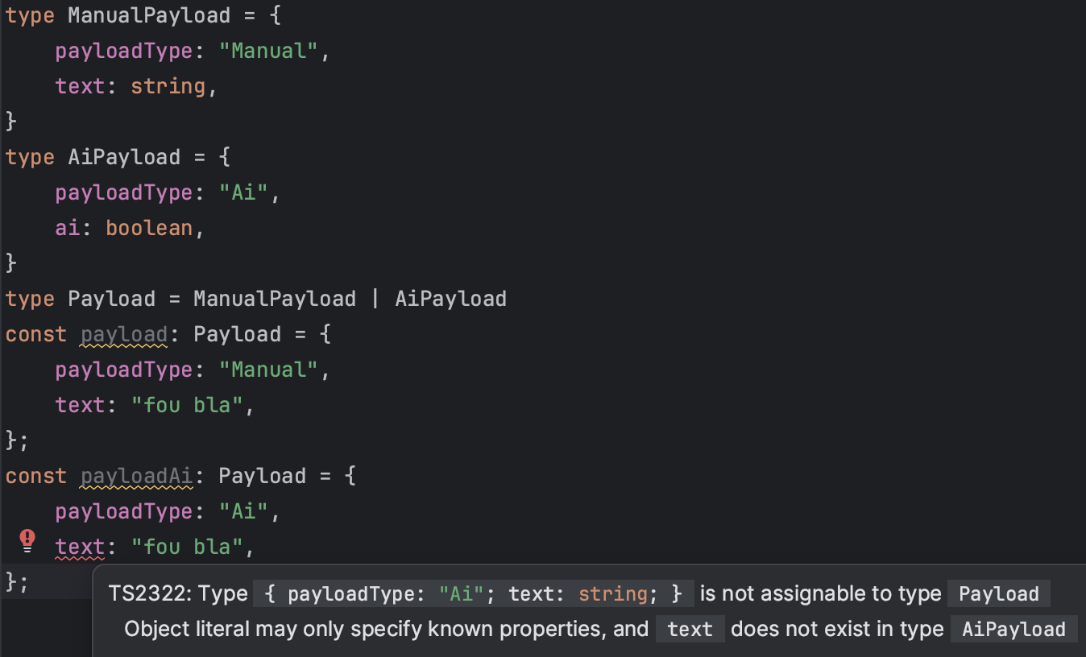
Typescript Unions
A union type in TypeScript allows a variable to have multiple types.
Still provides type safety during development.
Offers a powerful way to handle scenarios where a variable can have multiple types.
Notes:
Type Narrowing"

Slide 19
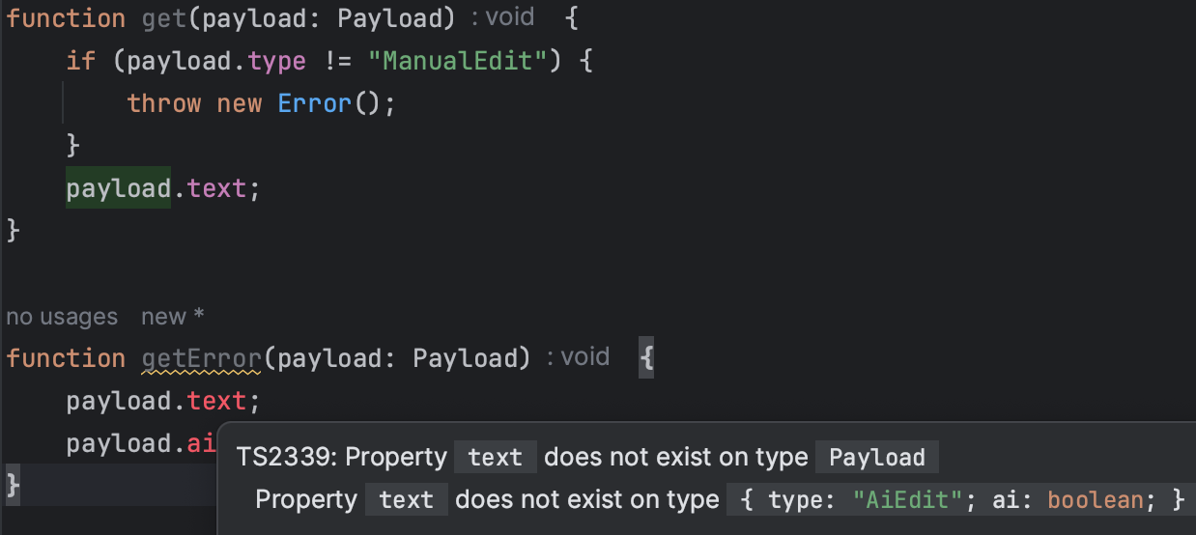
Type Narrowing
Also known as “control flow analysis”.
Allows the compiler to narrow down the type of a variable based on certain conditions in the code.
It's a mechanism that improves the accuracy of the type system by leveraging information from control flow statements.
Notes:
Type Narrowing"

Slide 20




Popular Framework
Express
Koa
Nest.js
Sail.js, Hapi.js, Meteor.js….
Vert.x: JVM framework inspired(?) by Node
Notes:
Express.js: Fast, unopinionated, minimalist web framework for Node.js
Minimal and flexible, allowing developers to structure their applications as needed.
Large and active community with a rich ecosystem of middleware and extensions.
Koa.js: Developed by the team behind Express, Koa focuses on a more modular and lightweight approach.
Aims to be a smaller, more expressive, and more robust foundation for web applications and APIs.
Nest.js:
A progressive Node.js framework for building efficient, scalable server-side applications.
Uses TypeScript and draws inspiration from Angular, providing a structured and extensible development approach
DI and varius design patterns and well-established solutions to the Node.js landscape
In summary, Vert.x was not directly inspired by Node.js, but both projects draw inspiration from similar principles, such as event-driven and non-blocking paradigms.

Slide 21
Workable Teams
Currently 25 apps using Node
The older version of Node used is 18.12
11 apps using Typescript
24 apps using Orka

Slide 22

Orka Framework
Battle tested node.js framework
Most workable node.js services are using orka
Unopinionated framework based on koa
https://github.com/Workable/orka

Slide 23
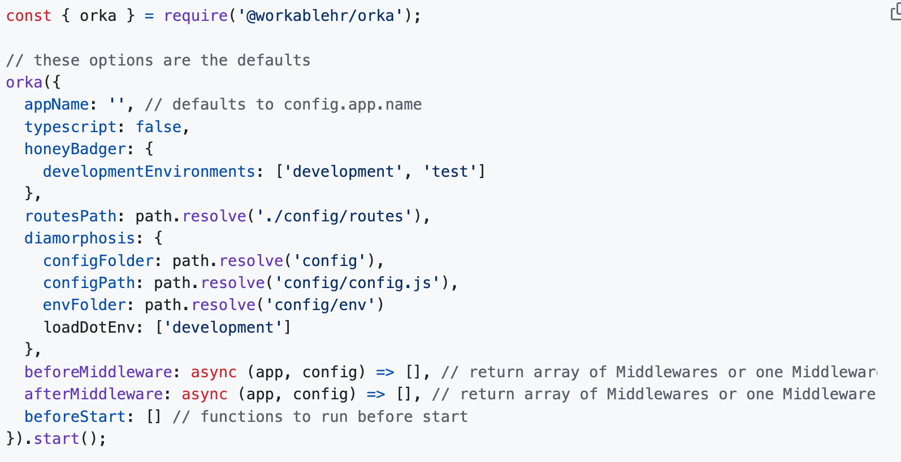
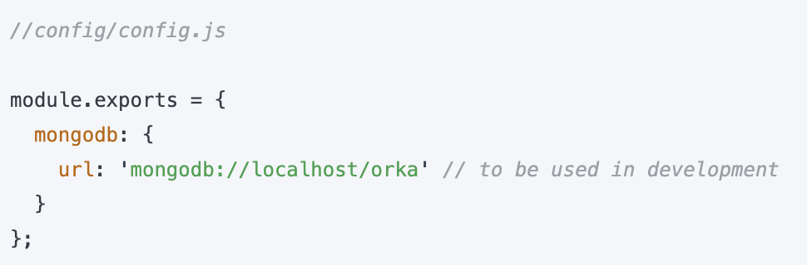
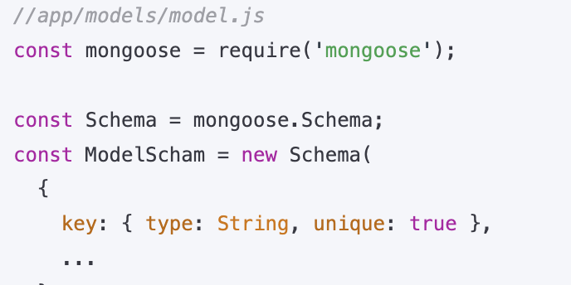
Orka Framework
Uses diamorphosis to load configuration from files and environment variables.
https://github.com/Workable/diamorphosis.
It integrates with many databases, brokers and services with little configuration overhead.
Notes:
Databases, Queues, Routes, Logging, Async context

Slide 24
But as all engineers
we have strong opinions

Slide 25

Keiko Framework
Introducing
Framework built on top of Orka
The Keiko name is taken from the famous orka
It is also the star of the Free Willy movie

Slide 26
Keiko Features
An overview of the
Single source of truth static types and runtime validation
Type safe routes definition
Autogenerated OpenAPI swagger from the routes definitions
Dependency Injection
Configuration management through DI
Drizzle ORM integration
Support for Aggregate and Event Sourcing patterns
DB Transaction management through decorators and async local storage
https://microservices.io/patterns/data/event-sourcing.html

Slide 27
Technical Deep Dive

Slide 28
Zod
const getArtistResponse = z.object({
id: z.string(),
name: z.string(),
url: z.string().url().optional(),
});
type GetArtistResponse = z.infer<typeof getArtistResponse>;
const artist = getArtistResponse.parse({
id: "123",
name: "King Gizzard and the Lizard Wizard",
url: "https://kinggizzardandthelizardwizard.com/",
});
Zod is a TypeScript-first schema declaration and validation library.
Keiko uses Zod definitions as single source of truth for both static and dynamic type checking.
It has great Typescript support that helped us implement the type safe features.

Slide 29
Keiko Init
const app = orka({
appName: "WorkableLite",
typescript: true,
diamorphosis: {
configFolder: `${__dirname}/config`,
configPath: __dirname + "/config/config",
envFolder: __dirname + "/config/env",
loadDotEnv: ["development"],
},
routesPath: `${__dirname}/routes`,
afterMiddleware: async (_app, _config) => [
koaSwagger({
routePrefix: "/backend/api-docs",
swaggerOptions: {
spec: require("../generated/swagger.json"),
},
}),
],
beforeStart: async config => {
Keiko.init({
name: "WorkableLite",
dataSource: DataSource,
modules,
namespaces,
policy: [middlewares.datadogMatchRoutes],
version: "1.0.0",
config,
description: "WorkableLite API specification",
});
},
errorHandler,
riviereContext,
});
Expose routes for orka import
Use the orka factory with Keiko.init in order to initialize Keiko

Slide 30
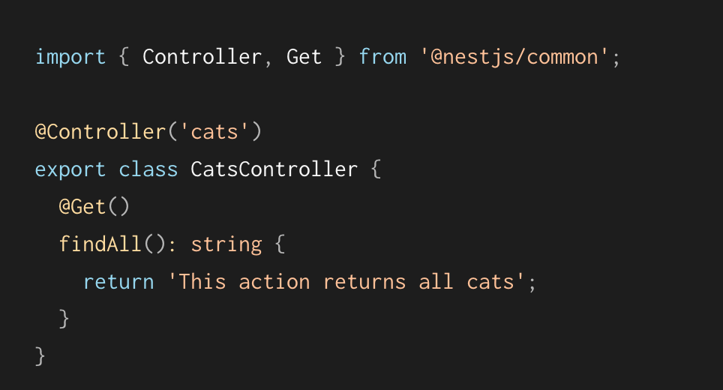
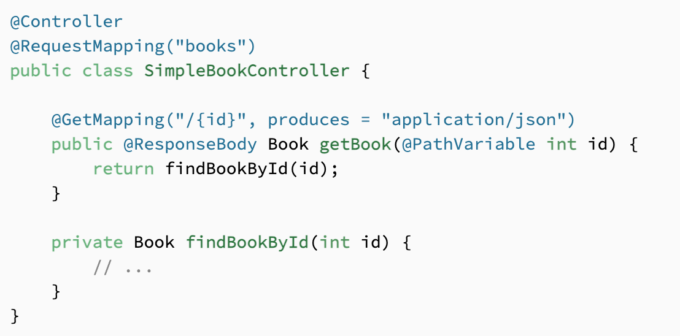
Controllers
Nest.js
Spring
Notes:
Single source of truth static types and runtime validation
Type safe routes definition
Autogenerated OpenAPI swagger from the routes definitions

Slide 31
Typed Routes
const route: Types.RouteEntryInput = {
namespace: namespaces.root,
pathSuffix: "artist/:artistId",
methods: {
get: Routes.makeRouteMethodHandler({
request: {
paramsSchema: getArtistParams,
},
responseSchema: getArtistResponse,
successStatusCode: 200,
description: "Returns the requested artist",
controller: ArtistController,
controllerMethod: "getArtist",
}),
},
};
Routes are defined with the RouteEntryInput type.
makeRouteMethodHandler:
checks the request and input types of the controller with the Zod validators
Executes run time validation on the request and response payloads

Slide 32
Controllers
@injectable()
class ArtistController {
async getArtist(req: {
params: GetArtistParams,
}): Promise<GetArtistResponse> {
return {
id: req.params.artistId,
name: "King Gizzard and the Lizard Wizard",
};
}
}
Injectable classes
Controllers are auto injected in Keiko
Each route method can define
request types for:
Params
Body
Query params
Context
response type

Slide 33
Namespaces
export type NamespaceKeys = "visitor"
| "session"
| "root";
export const namespaces: Types.NamespaceMap<NamespaceKeys> = {
visitor: { prefix: "backend/visitor" },
session: { prefix: "backend/session", policy: [isUser] },
root: { prefix: "" },
} as const;
Groups multiple routes under the same path prefix
Define policies used across all routes of the namespace

Slide 34
Modules
export const artistModule: Types.Module = {
name: "Artist",
injectables: [
{ provide: ArtistService, useClass: ArtistService },
],
routes,
};
Groups business domain code into discrete entities:
types
db schema
routes
controllers
services
errors
etc…

Slide 35
Policies
export const artistModule: Types.Module = {
name: "Artist",
injectables: [
{ provide: ArtistService, useClass: ArtistService },
],
policy: [someMiddleware],
routes,
};
Plain old Koa middlewares
Can be defined on the following levels:
global
namespace
module
route

Slide 36
Dependency Injection
@injectable()
class ArtistService {
async getArtist(): Promise<GetArtistResponse> {
return {
id: randomUUID(),
name: "King Gizzard and the Lizard Wizard",
};
}
}
@injectable()
class ArtistController {
constructor(@inject(ArtistService) private service: ArtistService) {}
async getArtist(_req: {
params: GetArtistParams,
}): Promise<GetArtistResponse> {
return this.service.getArtist();
}
}
Keiko uses inversify as the dependency injection framework.
Constructor injection is used.
By default the class name is used as injection token, but other injection tokens are also supported.

Slide 37
Config
@injectable()
class ArtistService {
constructor(
@inject(DiTypes.AppConfig) private config: AppConfig) {}
async getArtist(): Promise<GetArtistResponse> {
return {
id: this.config.ds.url,
name: "King Gizzard and the Lizard Wizard",
};
}
}
Diamorphosis config is also accessible through dependency injection

Slide 38
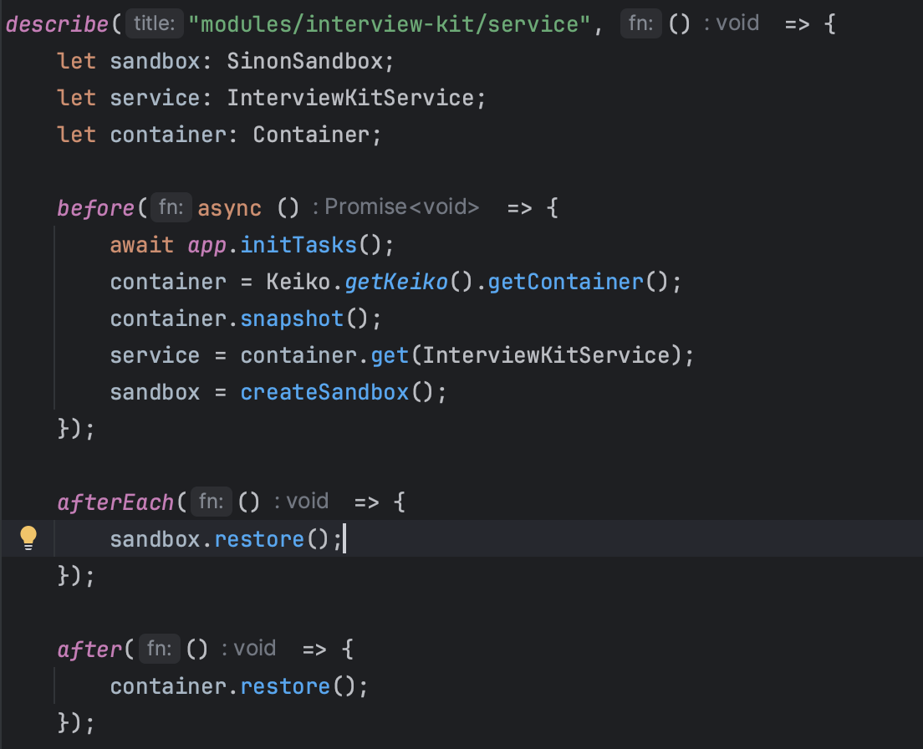
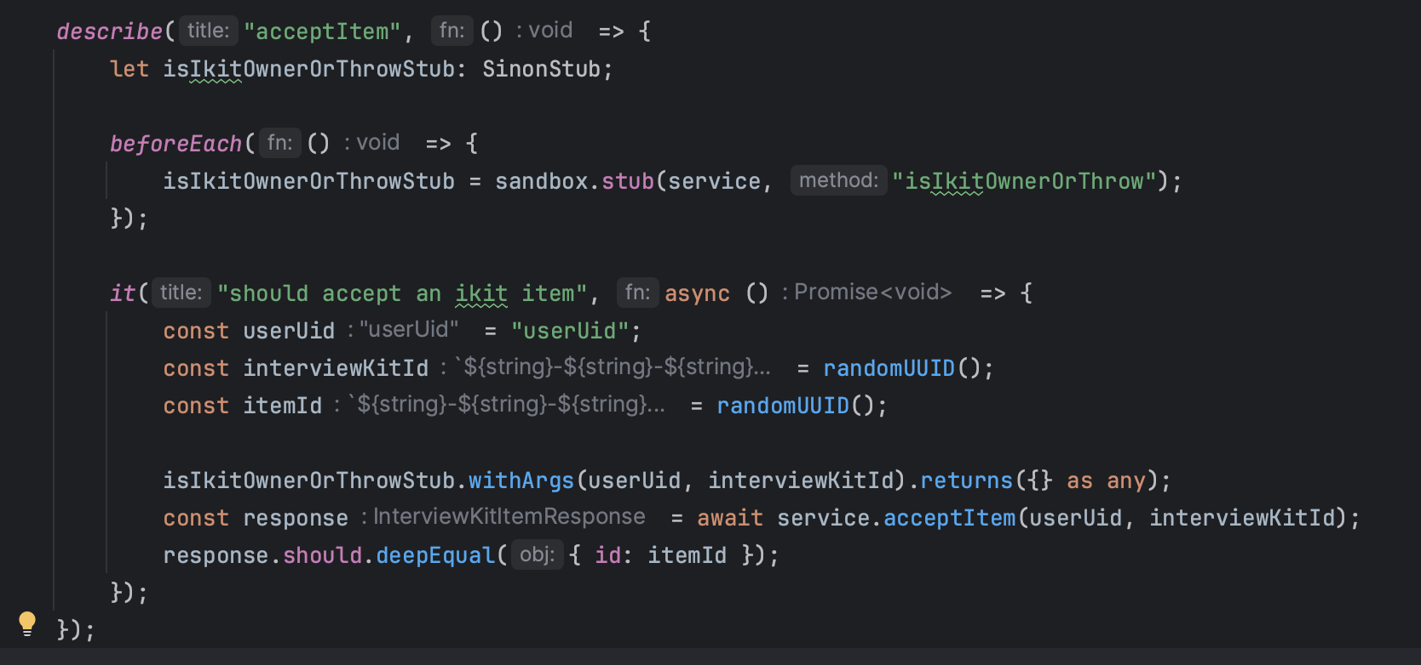
Testing
Mocha/Sinon/Should
DI helps us with its testability
Mountebank for integration testing
Notes:
Mocha / Jest/ Jasmine
Unit test/ integration test/ integration test for repositories / pending integration for kafka
Mocking is easy in javascript. Everything is an object

Slide 39
Event Sourcing
export type AggregateConfig<
Aggregate extends AggregateBase,
AggregateInit extends IAggregateInitializer<Aggregate>,
AggregateFetcher extends IAggregateFetcher<Aggregate>,
AggregateUpdater extends IAggregateUpdater<Aggregate>,
CommandsKeys extends string,
EventsKeys extends string,
> = {
handlerBindingKey: symbol;
eventLogSchema: EventLogTable,
aggregateSchema: AggregateTable,
initializerClass: interfaces.Newable<AggregateInit>,
fetcherClass: interfaces.Newable<AggregateFetcher>,
updaterClass: interfaces.Newable<AggregateUpdater>,
commandsRules: { [key in CommandsKeys]: BusinessRule<
key, any, EventsKeys, Aggregate, any, any> };
eventsRules: { [key in EventsKeys]: EventRule<
Aggregate, key, any> };
};
Keiko allows a module to define an aggregate that is updated using event sourcing
Provides abstractions for commands executions and events persistence
But this could be a separate presentation
Notes:
It is used for versioning and undo/redo of the aggregate
Events are broadcasted to other systems

Slide 40

ORM Candidates
Knex
Objection
Prisma
Drizzle
IMAGE
Notes:
Knex: no typescript, query builder
Objection: no typescript, abandoned
Prisma: DSL diko tous. DB agnostic, Magic stuff
Drizzle

Slide 41
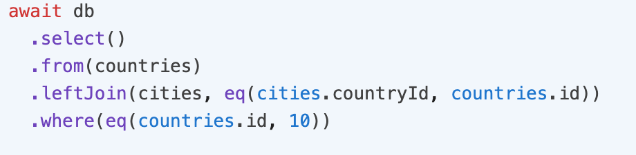
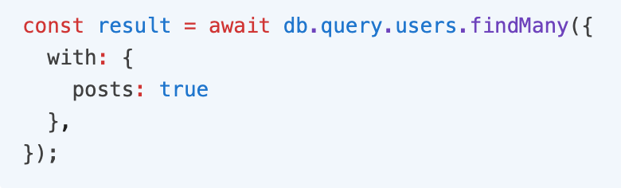
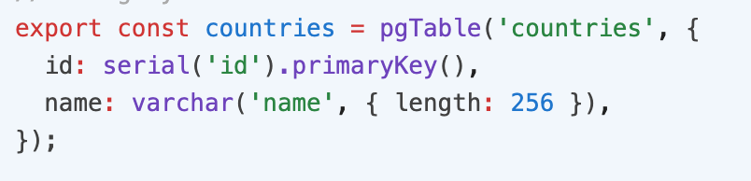
Drizzle ORM
Relational and SQL-like query APIs
Strong Zod Support
Battle tested…..not 🙃
IMAGE

Slide 42
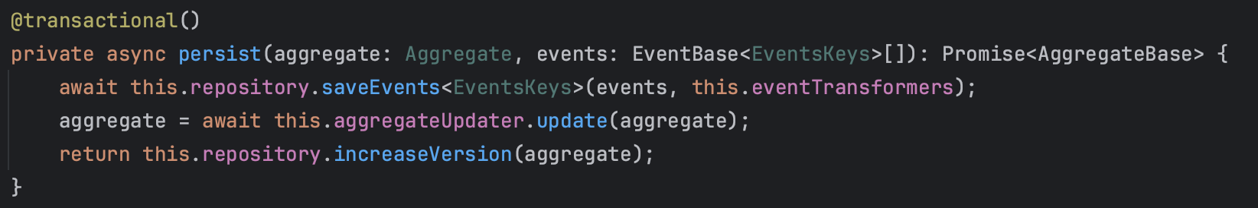
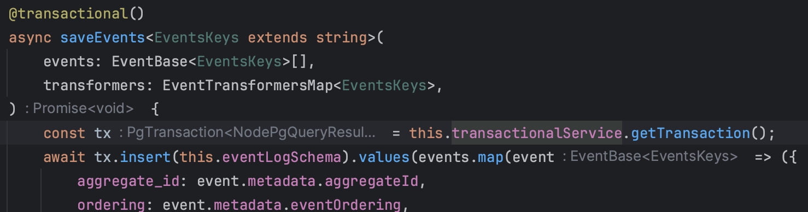
Transactional Decorator
Transactional Service is available through DI
Uses local storage
An error is thrown if @transactional() decoration is missing on the execution chain

Slide 43
Future Work
Independent npm module
Better integration with Orka
Reduce Keiko boilerplate
Improve Keiko type safety
Reduce testing suite boilerplate with Keiko utils

Slide 44
Conclusion
Decisions Decisions Decisions - Dan North
Software patterns are just ideas
We choose to use what is fit for us

Slide 45
Thank you

